Slide 1
Java Language Fundamentals

Slide 2
Version Control and Revision History
 | Name | Date
Prepared By | Paranthaman | 09-07-2019
Reviewed By | Team | 09-07-2019
Approved By | Team | 09-07-2019
Version No. | Date | Affected Sections | Highlights
2.0.0 |  | ALL | Updated Based on the course sheet coverage

Slide 3








Iconic Representations.......
Test your Memory
Can you Solve?
Objective
Coffee Break
Queries
Recap
Need more Info
Brainstorm

Slide 4
Objectives
Data Types
Variable
Key word
Constants and Literals
Operators
Controls statement
If statements
Switch statements
Loop Statements
Array
Packages
Main Method

Slide 5
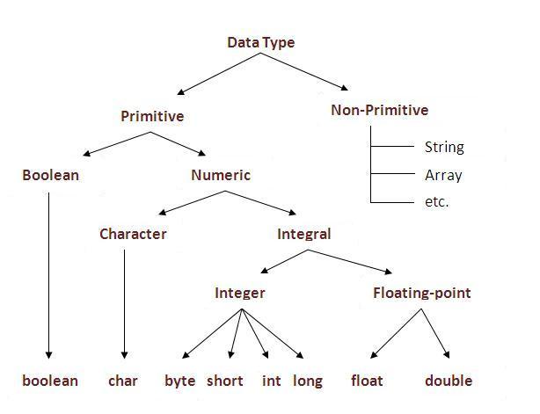
Data Types
Data types are two categories in JAVA
Primitive types
There are 8 primitive types
Non primitives types (Reference Types)
All the remaining are Reference types
Examples
Enum
Array
Class

Slide 6
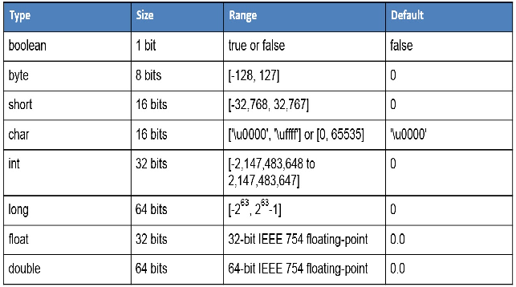
Primitive Types

Slide 7
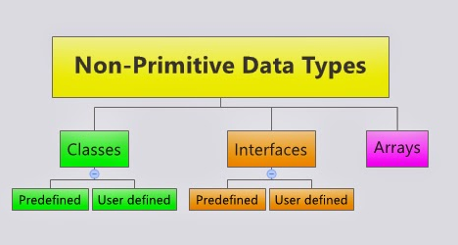
Non Primitive Types

Slide 8
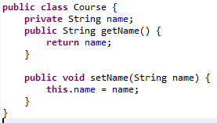
Primitive Vs. reference types
int a =100; int b=a;
a=200;
Course c1=new Course(“JAVA”;)
Course c2=c1;
c2.setName(“J2EE”);
c2=new Course(“Struts”);
100
100
200
100
@10101
@10101
Java
@10101
10111
Struts
@10111

Slide 9
Java Identifiers
All java components require names. Names used for classes, variables and methods are called identifiers.
All identifiers should begin with a letter (A to Z or a to z ), currency character ($) or an underscore (_).
After the first character identifiers can have any combination of characters.
A key word cannot be used as an identifier.
Most importantly identifiers are case sensitive.
Examples of legal identifiers:age, $salary, _value, __1_value
Examples of illegal identifiers : 123abc, -salary

Slide 10
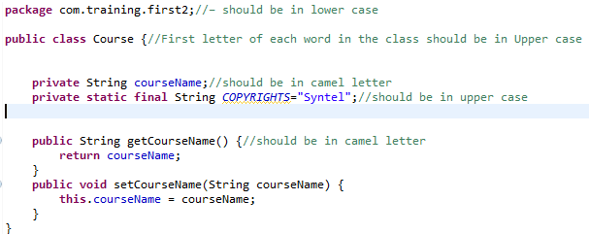
Java Standard Names
Package name – should be in lowercase
Class name – First letter of the word should be in Uppercase
Variable and methods – should be in camel letter
Final variable – should be in upper case
Sample code:

Slide 11
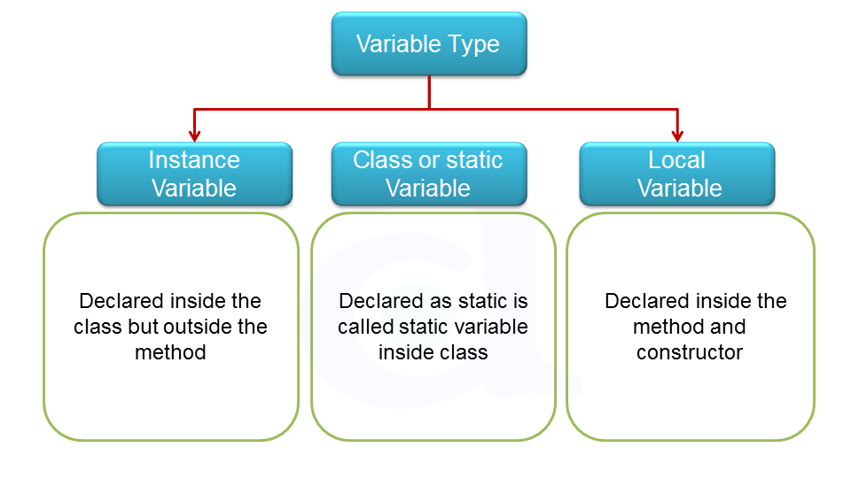
Scope of Variables

Slide 12
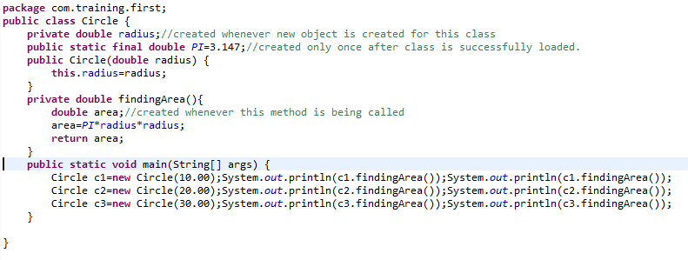
Scopes of Variable
Radius- 10.00
Area-314
Area-314
PI-3.147
Radius-20.00
Area-1258.8
Area-1258.8
Radius-30.00
Area-2832.3
Area-2832.3

Slide 13
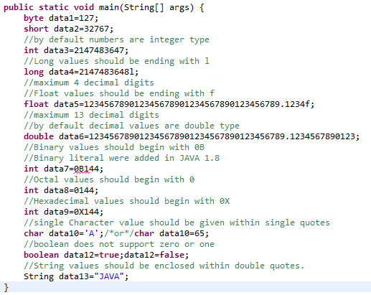
Java Literals
Java Literals

Slide 14
Underscores in Numeric Literals from Java 7.0
Declaring numeric literals with underscores would have caused a compile error in any previous release of the language. But in Java 7 numeric literals with underscore characters are allowed.
You can place any number of underscore(_) between digits of numeric literals.
This added feature improves the readability of the code.
You can’t place underscore in the following places:
You can’t place it at the beginning or at the end of a number.
Adjacent to a decimal point in a floating point literal.
Before to an F or L suffix.
In positions where a string of digits is expected.
Sample Coding:
long creditCardNumber = 1234_5678_9012_3456L;
long socialSecurityNumber = 999_99_9999L;
float pi = 3.14_15F;
long hexBytes = 0xFF_EC_DE_5E;
long hexWords = 0xCAFE_BABE;
long maxLong = 0x7fff_ffff_ffff_ffffL;

Slide 15
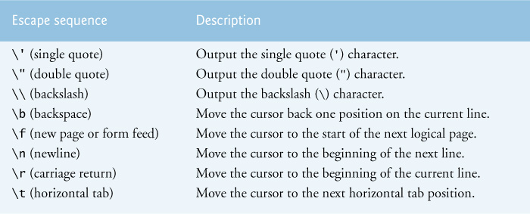
Escape sequences

Slide 16
Java Operators
Java provides a rich set of operators to manipulate variables. We can divide all the Java operators into the following groups:
Arithmetic Operators
Relational Operators
Bitwise Operators
Logical Operators
Assignment Operators
Misc. Operators

Slide 17
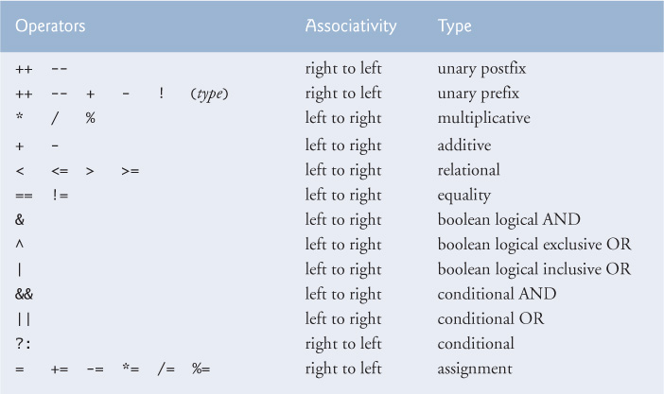
Precedence of Java Operators

Slide 18
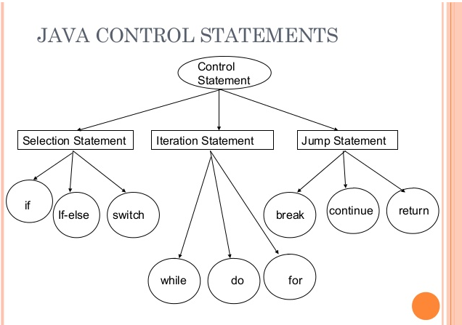
JAVA Control Statements

Slide 19
Rules for switch case in JAVA
The following rules apply to a switch statement:
The variable used in a switch statement can only be a byte, short, int, char, or (String from Java 1.7).
You can have any number of case statements within a switch. Each case is followed by the value to be compared to and a colon.
The value for a case must be the same data type as the variable in the switch, and it must be a constant or a literal.
When the variable being switched on is equal to a case, the statements following that case will execute until a break statement is reached.
When a break statement is reached, the switch terminates, and the flow of control jumps to the next line following the switch statement.
Not every case needs to contain a break. If no break appears, the flow of control will fall through to subsequent cases until a break is reached.
A switch statement can have an optional default case, which must appear at the end of the switch. The default case can be used for performing a task when none of the cases is true. No break is needed in the default case.

Slide 20
Jump Statements
The break Keyword:
The break keyword is used to stop the entire loop. The break keyword must be used inside any loop or a switch statement.
The break keyword will stop the execution of the innermost loop and start executing the next line of code after the block.
The continue Keyword:
The continue keyword can be used in any of the loop control structures. It causes the loop to immediately jump to the next iteration of the loop.
In a for loop, the continue keyword causes flow of control to immediately jump to the update statement.
In a while loop or do/while loop, flow of control immediately jumps to the Boolean expression.
Return Keyword:
A method may return a value. The return value type is the data type of the value the method returns. Some methods perform the desired operations without returning a value. In this case, the return value type is the keyword void.
When a program calls a method, program control is transferred to the called method. A called method returns control to the caller when its return statement is executed or when its method-ending closing brace is reached.

Slide 21
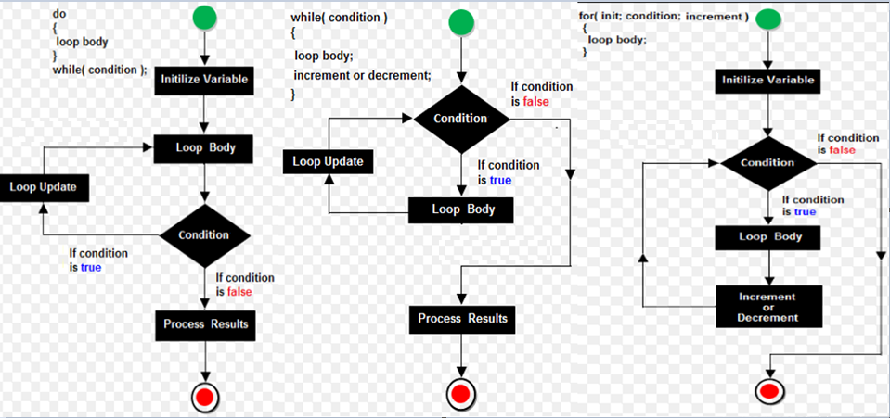
Flow Chart for Loop Statements

Slide 22
Array
The array, which stores a fixed-size sequential collection of elements of the same type.
It allocate memory continuously .
Index is used access the elements of array
Index always begin from 0 to length-1.
Raises exception for “ArrayIndexOutOfBounds” if index is invalid.
Length property get the size of the array
Array can be
One dimensional array
Storing single row or column values
Two dimensional array
Storing different structure of values like one table, multiple tables, and Su do Ku.

Slide 23
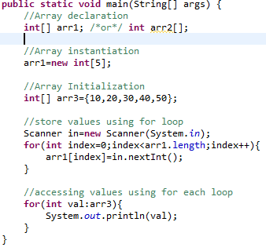
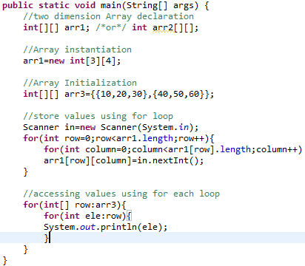
Array Syntax

Slide 24
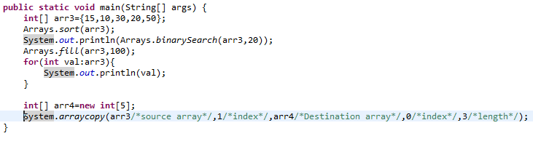
Arrays Class & arraycopy method

Slide 25
Methods
A Java method is a collection of statements that are grouped together to perform an operation.
Modifiers: The modifier, which is optional, tells the compiler how to call the method. This defines the access type of the method.
Return Type: A method may return a value. The returnValueType is the data type of the value the method returns. Some methods perform the desired operations without returning a value. In this case, the returnValueType is the keyword void.
Method Name: This is the actual name of the method. The method name and the parameter list together constitute the method signature.
Parameters: A parameter is like a placeholder. When a method is invoked, you pass a value to the parameter. This value is referred to as actual parameter or argument. The parameter list refers to the type, order, and number of the parameters of a method. Parameters are optional; that is, a method may contain no parameters.
Method Body: The method body contains a collection of statements that define what the method does.

Slide 26
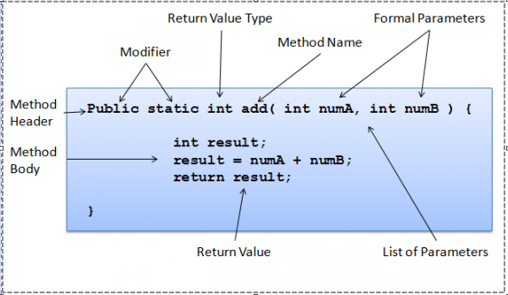
Syntax of the Method

Slide 27
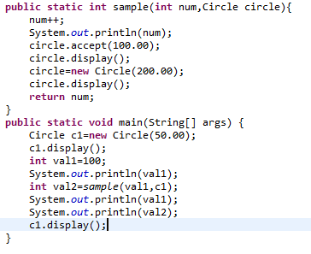
Pass By Value | Pass By Reference | Return value
Argument receives the values from calling statement and return type sends the value to calling statement.

Slide 28
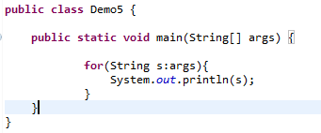
Command Line Arguments
Command line arguments allow the user to affect the operation of an application.
When invoking an application, the user types the command line arguments after the application name.
In the Java language, when you invoke an application, the runtime system passes the command line arguments to the application's main method via an array of Strings. Each String in the array contains one of the command line arguments.
C:/>java Demo5 arg1 arg2 arg3

Slide 29
Packages in Java
A package is a grouping of related types providing access protection and name space management. Note that types refers to classes, interfaces, enumerations, and annotation types.
Package names are written in all lower case to avoid conflict with the names of classes or interfaces.
Creating package
package com.syntel.mypackage.
To use a public package member from outside its package, you must do one of the following:
Refer to the member by its fully qualified name
java.util.Scanner in=new java.util.Scanner(System.in);
Import the package member
import java.util.Scanner;import java.util.List;import java.util.LinkedList;
public class Demo {
public static void main(String[] args) {
Scanner in=new Scanner(System.in);
List<Dog> list=new LinkedList<Dog>();
}
}
Import the entire members of package
import java.util.*;
public class Demo {
public static void main(String[] args) {
Scanner in=new Scanner(System.in);
List<Dog> list=new LinkedList<Dog>();
}
}
import only static members of Class introduced from Java 1.5
import static java.util.Map.*;
public class Demo {
public static void main(String[] args) {
//this is static member of class Map
Entry<Integer,String> entry;
}
}

Slide 30
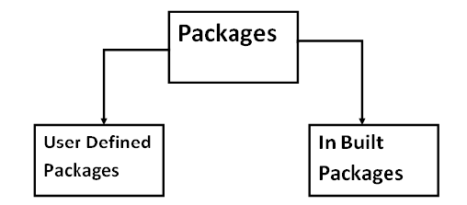
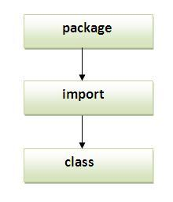
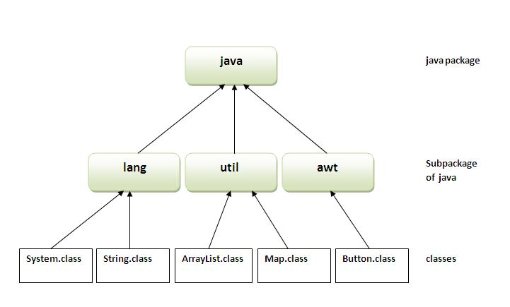
Package in Java

Slide 31
Questions and Answers

